Slide 1
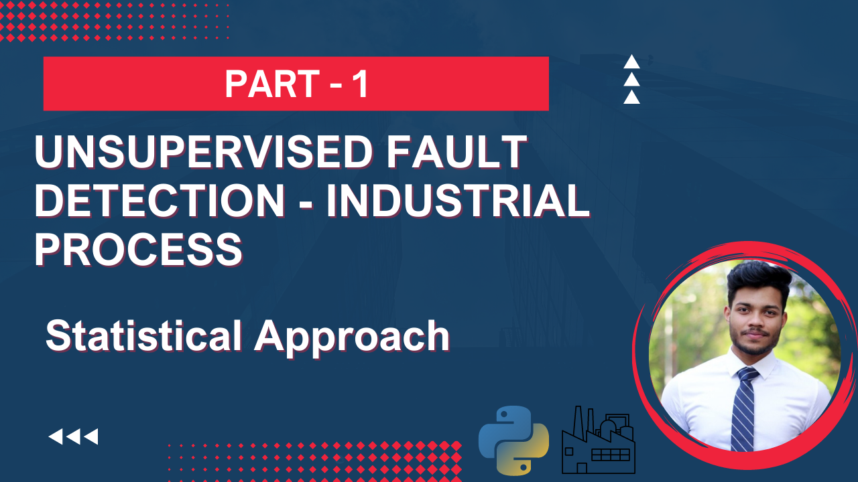

Slide 2
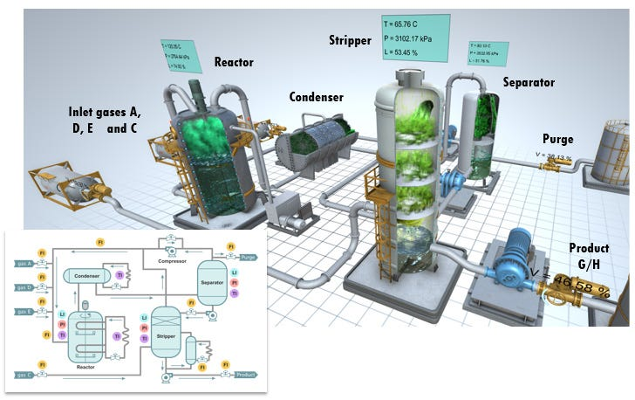




Tennessee Eastman Process (TEP)
$$X_{1}$$
$$X_{2}$$
Sensor Values
$$…$$
$$X_{55}$$
The Tennessee Eastman Process is a well-known benchmark process used in chemical engineering to evaluate process control and fault detection methods. The goal of fault detection is to identify when the process is operating abnormally, which can lead to product quality issues, equipment damage, and safety hazards.

Slide 3
The Big Picture
Perform Unsupervised Learning, only using the Fault Free data, to be able to detect process anomalies
$$X_{1}$$
$$X_{2}$$
Sensor Values
$$…$$
$$X_{55}$$

Slide 4
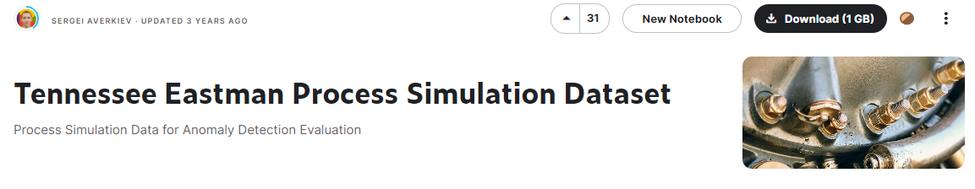
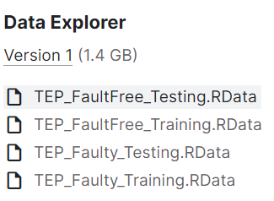
Dataset

Slide 5
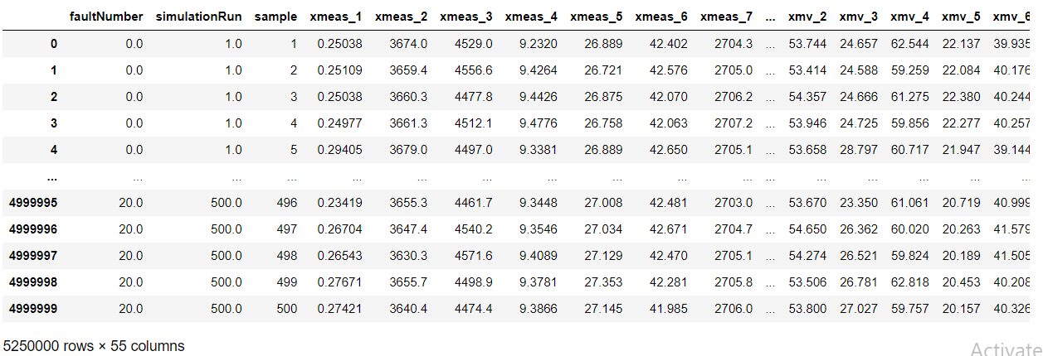
Dataset
20 different fault types were introduced

Slide 6
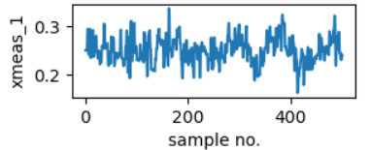
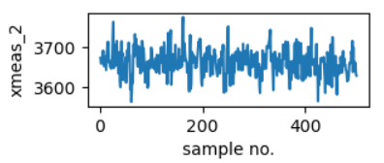
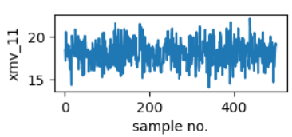
faultNumber = 0 (Fault Free condition)
simulationRun=1
simulationRun=2
simulationRun=3
55 different sensor values
…
simulationRun=500
…

Slide 7
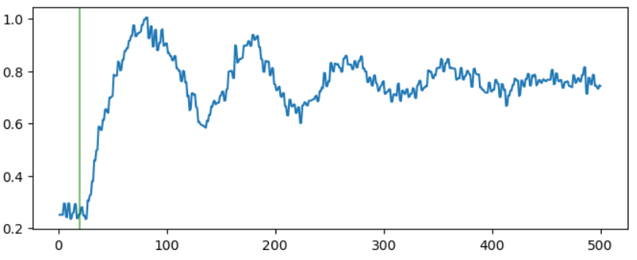
Introduction of Fault
In the training data the fault is introduced after 1 hour
In test data, fault is introduced after 8 hour
With sampling rate of 3min, the fault is introduced after 20th sample in Training Faulty data

Slide 8
Statistical Method of Fault Detection

Slide 9
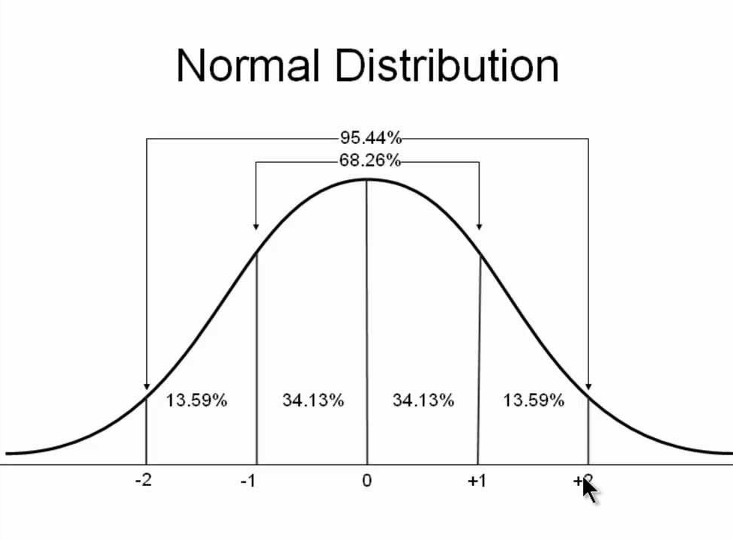



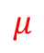

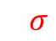
faultNumber = 0 (Fault Free condition)
simulationRun=1
simulationRun=2
…
simulationRun=500
Histogram
$$X_{1}$$
$$μ$$
$$3σ$$
$$X_{2}$$
$$…$$
…
…
…
$$X_{52}$$

Slide 10
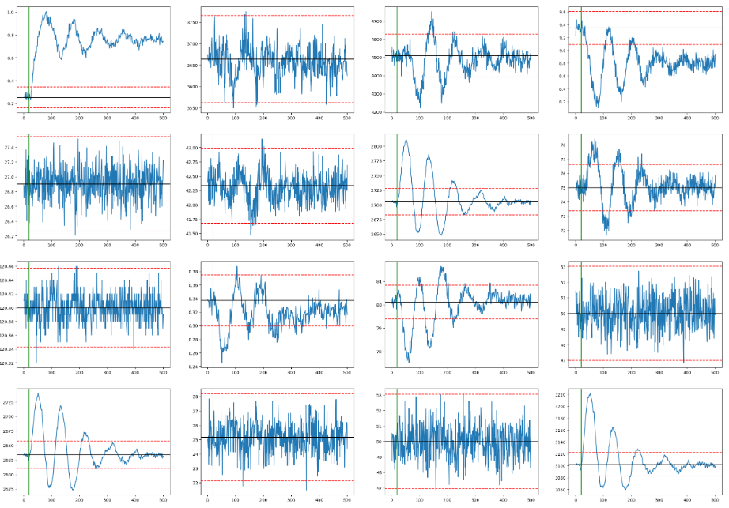
One has to look at 55 subplots all the time
Combine these 55 subplots into a single Process parameter

Slide 11
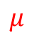


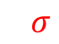









Threshold testing for Fault detection
upperLimit = $μ+3⋅σ$
lowerLimit = $μ−3⋅σ$
$$X_{1}$$
If $X_{1}>UL_{1}$OR $X_{1}<LL_{1}$
$$μ$$
$$3σ$$
OR
$$X_{2}$$
$\text{If} X_{2}>UL_{2}$OR $X_{2}<LL_{2}$
OR
1 or 0
$$…$$
$$…$$
If any of the variable
crosses threshold, then
the output will be =1
OR
$$X_{52}$$
$\text{If} X_{52}>UL_{52}$OR $X_{52}<LL_{52}$
At time = $t$

Slide 12
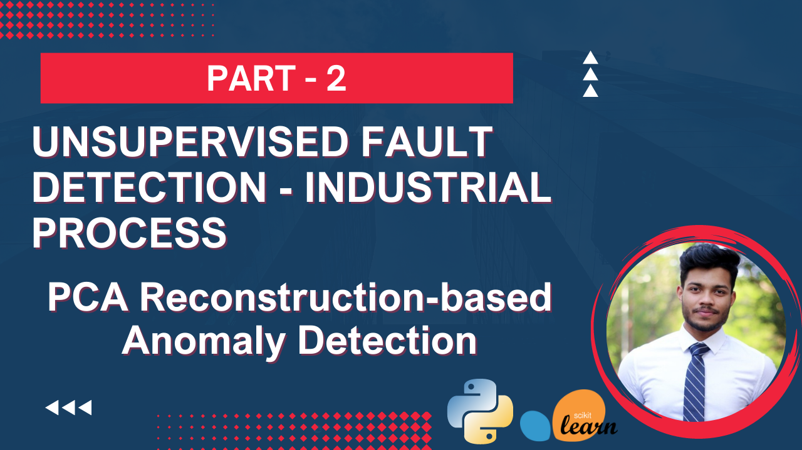

Slide 13
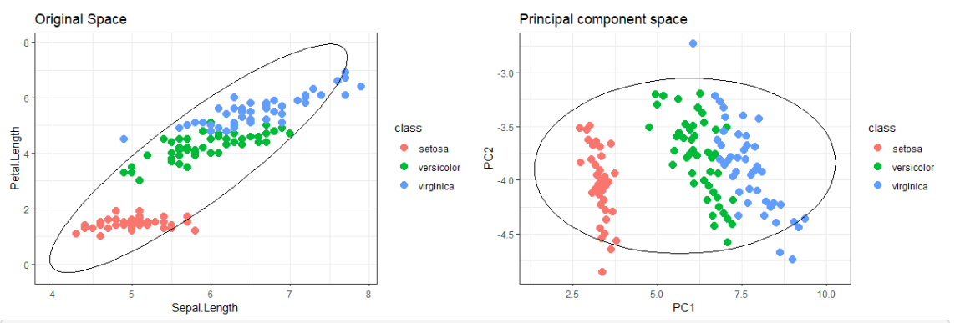
PCA Analysis

Slide 14



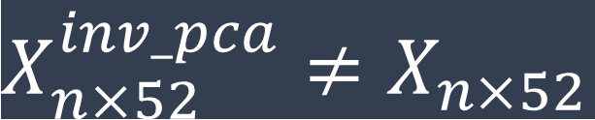
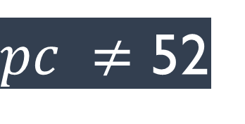

Intuition of PCA
$X_{n×52}$is the dataset
$W_{52×pc}$ is learned during PCA.fit()
$pc ≠$ 52
$$X_{n×pc}^{pca}=X_{n×52}×W_{52×pc}$$
$$X_{n×52}^{inv_pca}=InversePCA(X_{n×pc}^{pca})$$
$X_{n×52}^{inv_pca}≠$ $X_{n×52}$

Slide 15
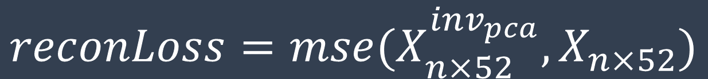
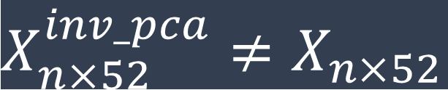
Reconstruction loss
$X_{n×52}^{inv_pca}≠$ $X_{n×52}$
$$reconLoss=mse(X_{n×52}^{inv_{pca}},X_{n×52})$$
Hopefully for Anomaly data this reconstruction error will be high
We can easily detect the anomaly by just using a ‘Threshold’

Slide 16
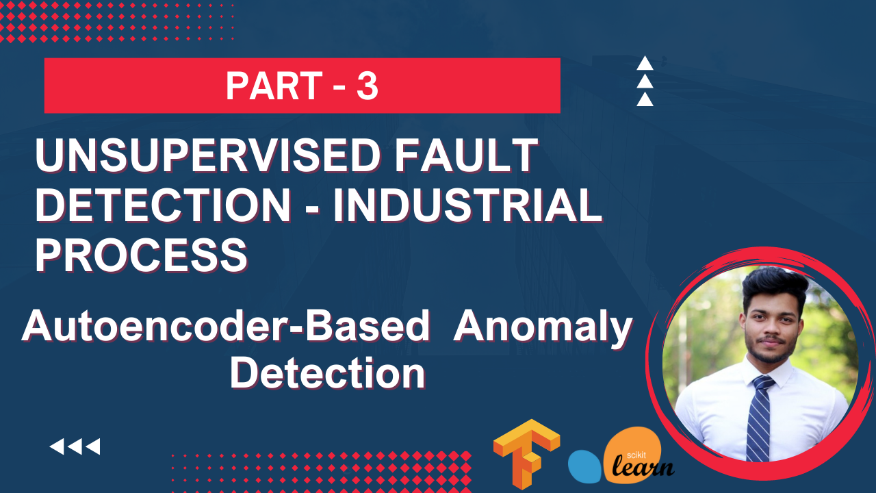

Slide 17
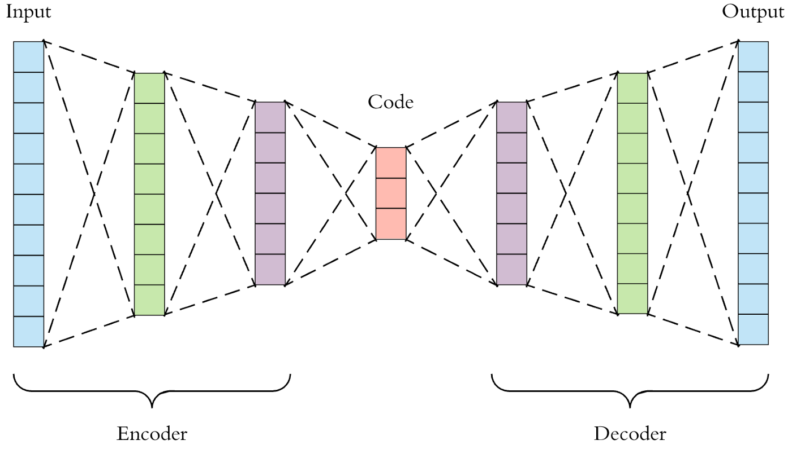


Autoencoders
$$X$$
$$\hat{X}$$
Only Fault Free data

Slide 18
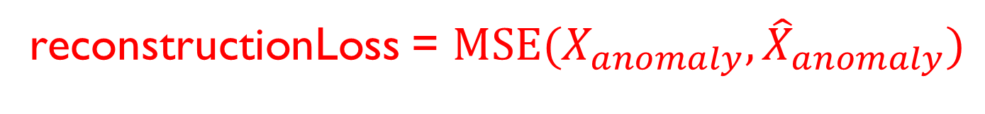

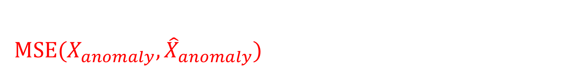


Autoencoders
$$X$$
$$\hat{X}$$
reconstructionLoss = $MSE(X,\hat{X})$
If the autoencoder is trained well it will have less $MSE(X,\hat{X})$
reconstructionLoss = $MSE(X_{anomaly},{\hat{X}}_{anomaly})$
For anomaly data, which the autoencoder has not seen….
$MSE(X_{anomaly},{\hat{X}}_{anomaly})$ will be very high

Slide 19
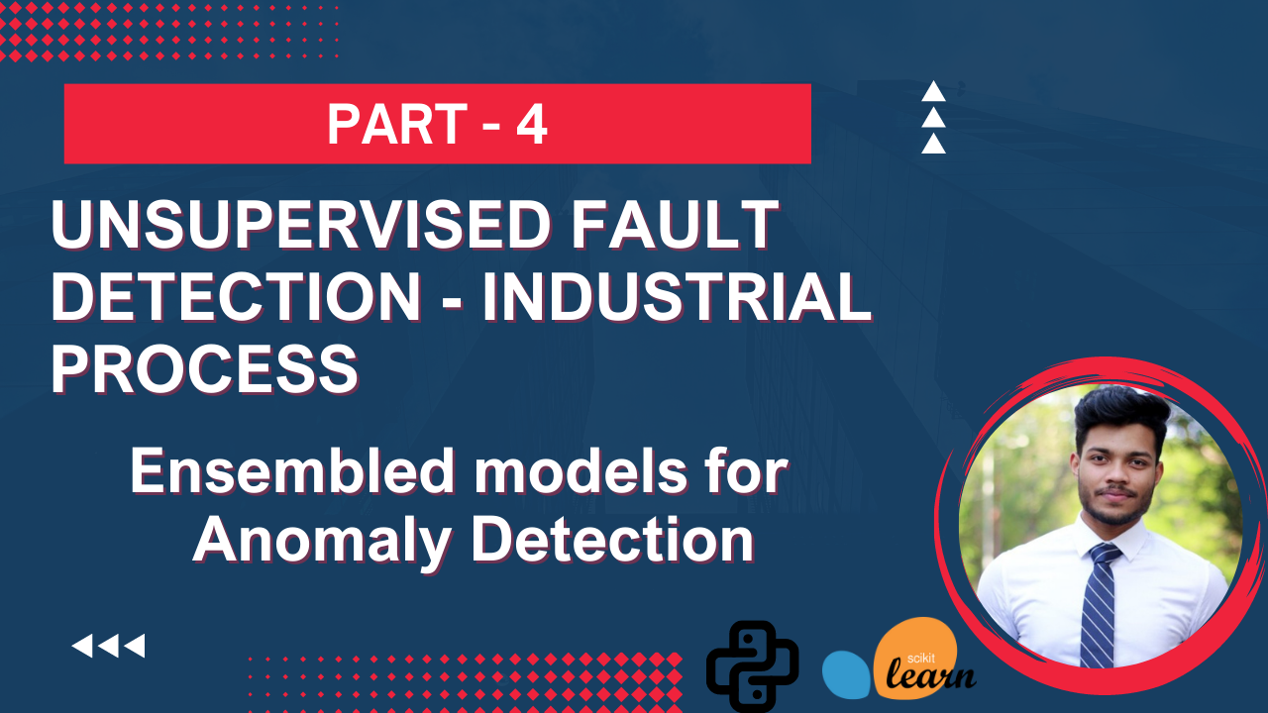

Slide 20








What is Ensembled Methods
$$X$$
ML-1
$$Y_{1}$$
$$X$$
$$Y_{2}$$
ML-2
Combined to obtain
robust decision
$$Y$$
$$…$$
$$X$$
ML-N
$$Y_{3}$$

Slide 21









Ensemble method to reconstruct
$$X_{1}$$
$$X_{2}$$
$$X_{3}$$
$$…$$
$$X_{52}$$
ML-1
$$X_{1}$$
$$X_{1}$$
$$X_{2}$$
$$X_{3}$$
$$…$$
$$X_{52}$$
ML-2
$$X_{2}$$
$$X$$
$$\hat{X}$$
$$…$$
$$X_{1}$$
$$X_{2}$$
$$X_{3}$$
$$…$$
$$X_{52}$$
ML-N
$$X_{52}$$

Slide 22






Ensemble method to reconstruct
N – Ensembled methods
$$X_{1}$$
$$X_{1}$$
$$X_{2}$$
$$X_{3}$$
$$…$$
$$X_{52}$$
$$X_{2}$$
$$\hat{X}$$
$$X$$
$$…$$
$$X_{52}$$

Slide 23
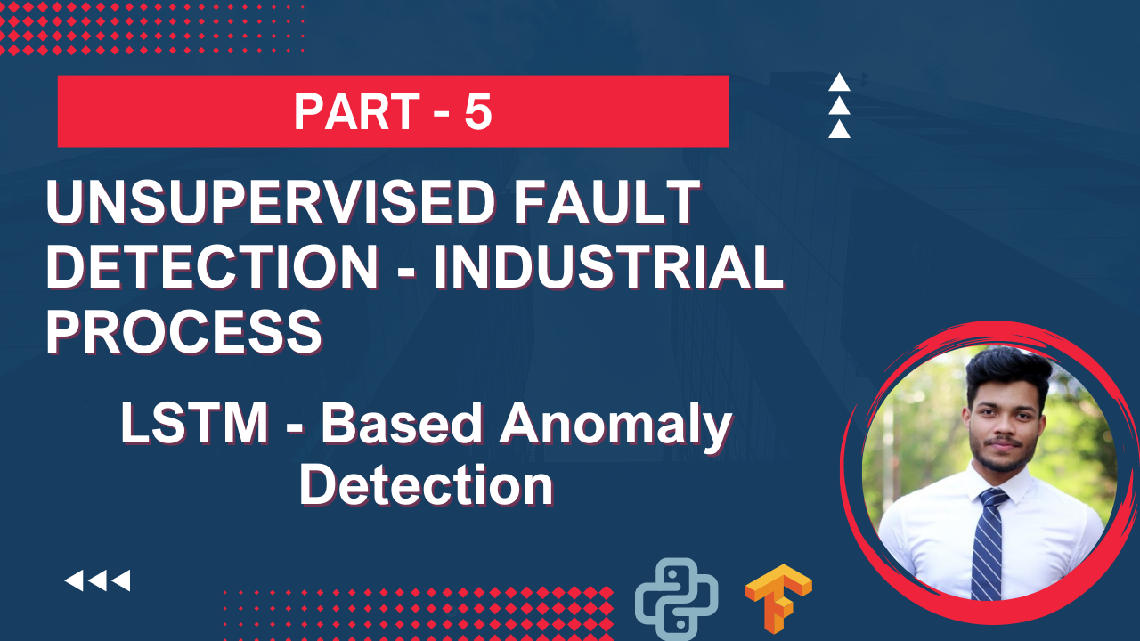

Slide 24
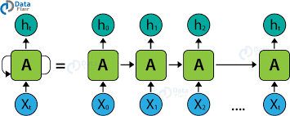
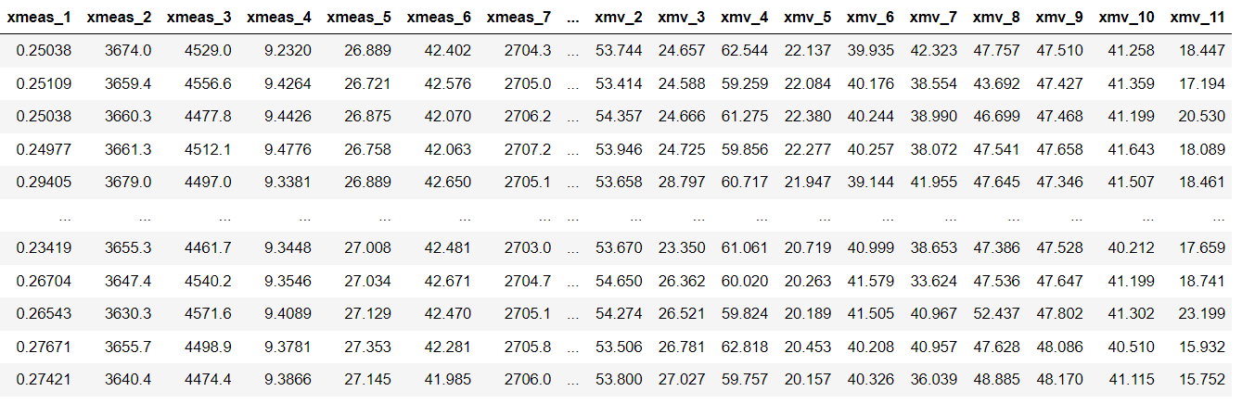
Data Pre-processing (Sliding Window)

Slide 25
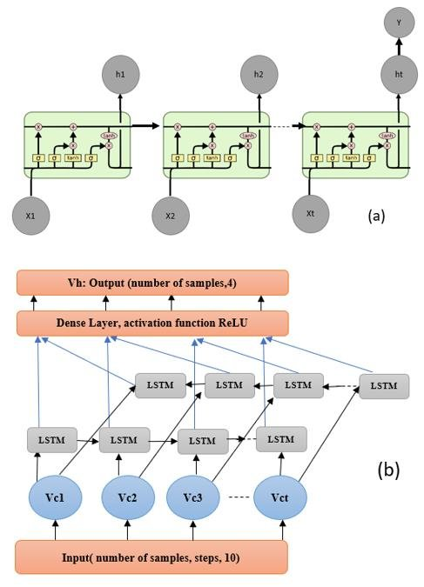
LSTM- Based anomaly detection

Slide 26





Reconstruction Error
$$X∈R^{n×w×52}$$
$$\hat{Y}∈R^{n×52}$$
Fault Free
Training of LSTM
$$X$$
$$\hat{Y}$$
MSE($\hat{Y}$ and $Y$) very high
Faulty

Slide 27
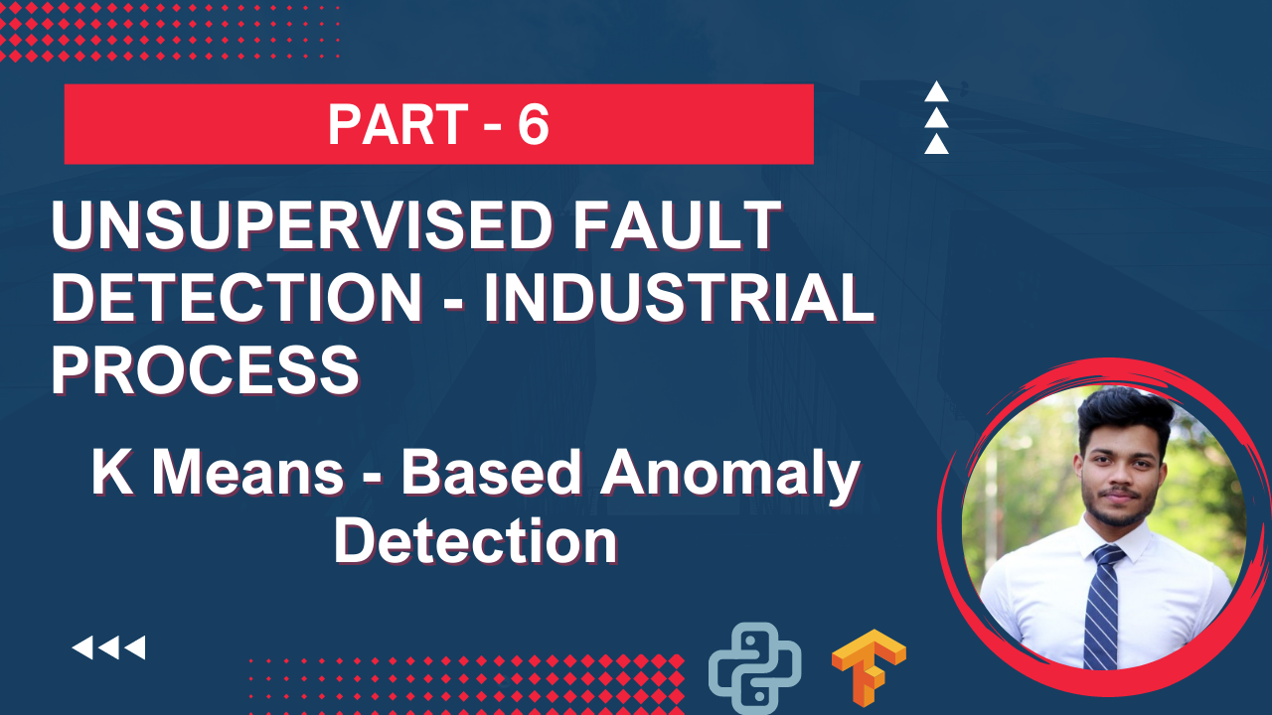

Slide 28
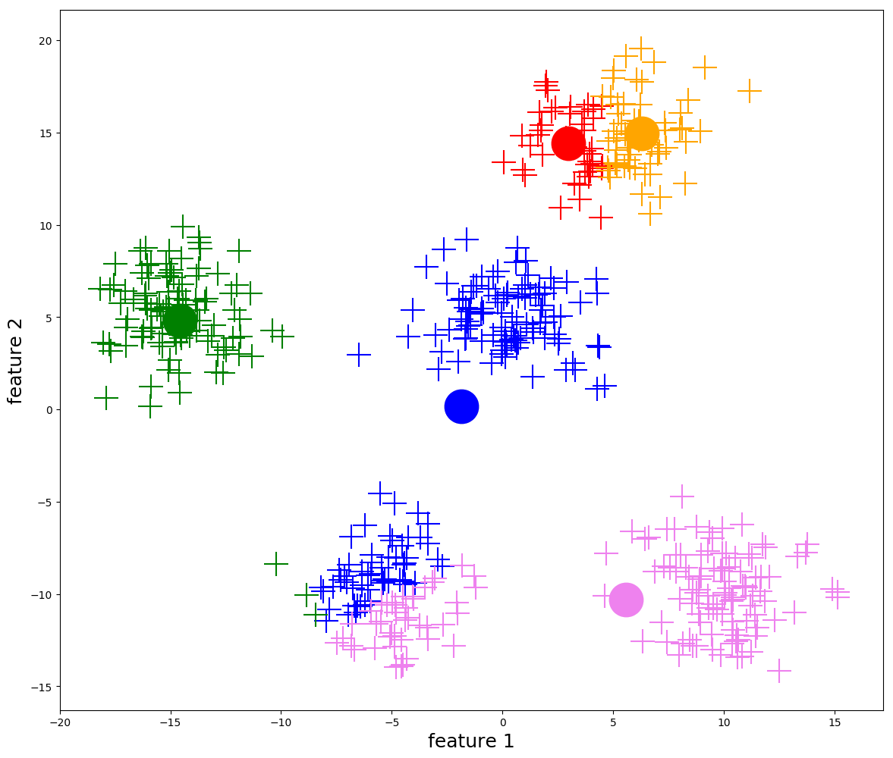
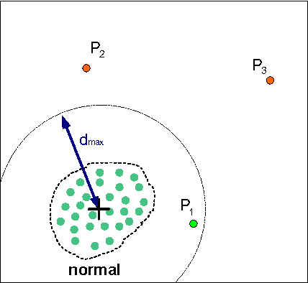
K means clustering

Slide 29
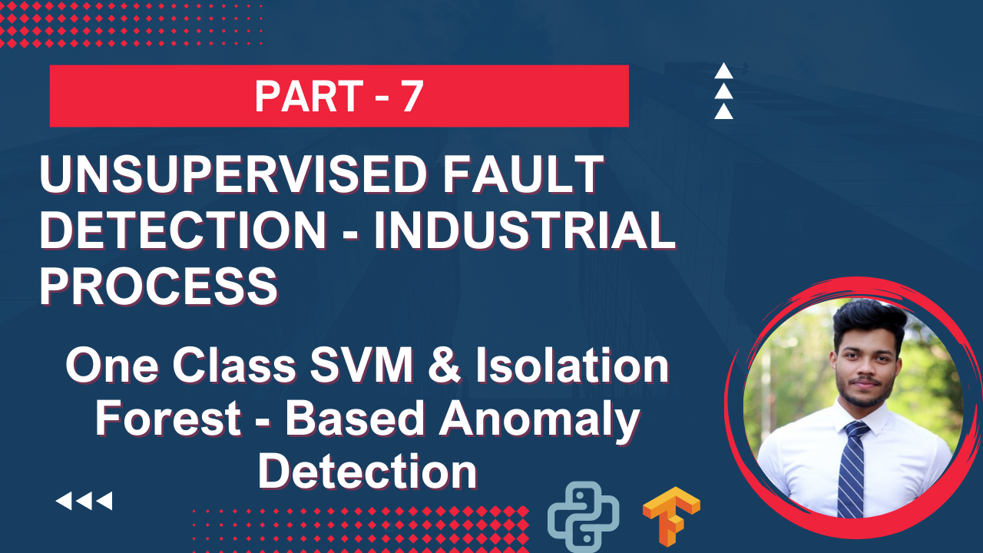

Slide 30
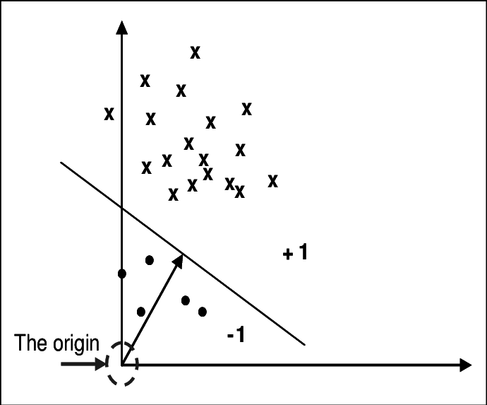
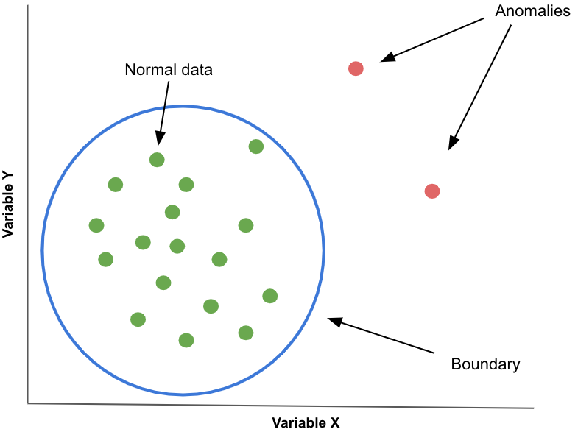
One Class SVM

Slide 31
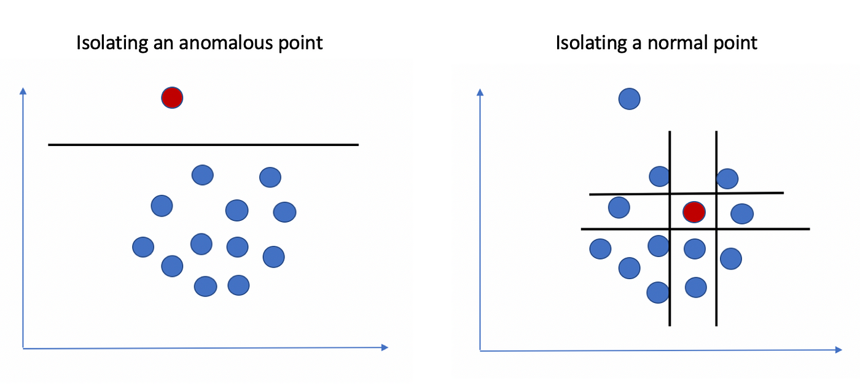
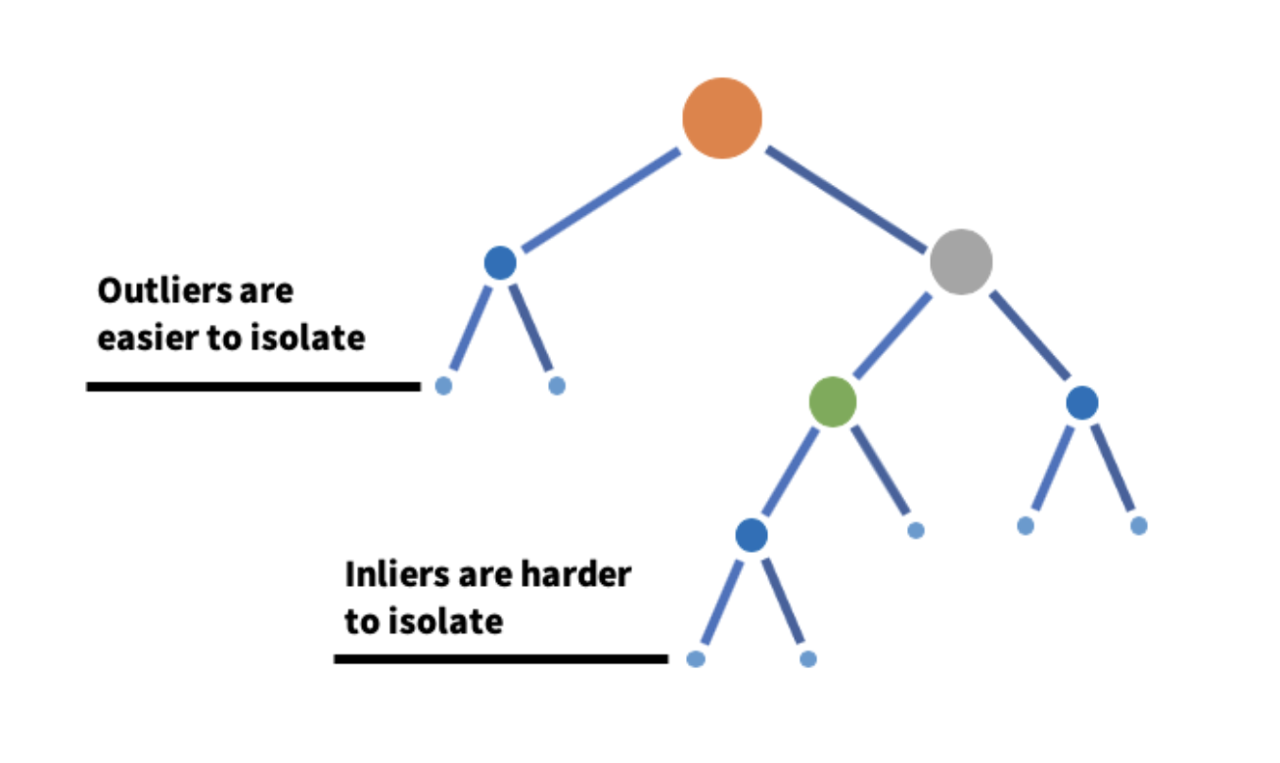
Isolation Forest

Slide 32
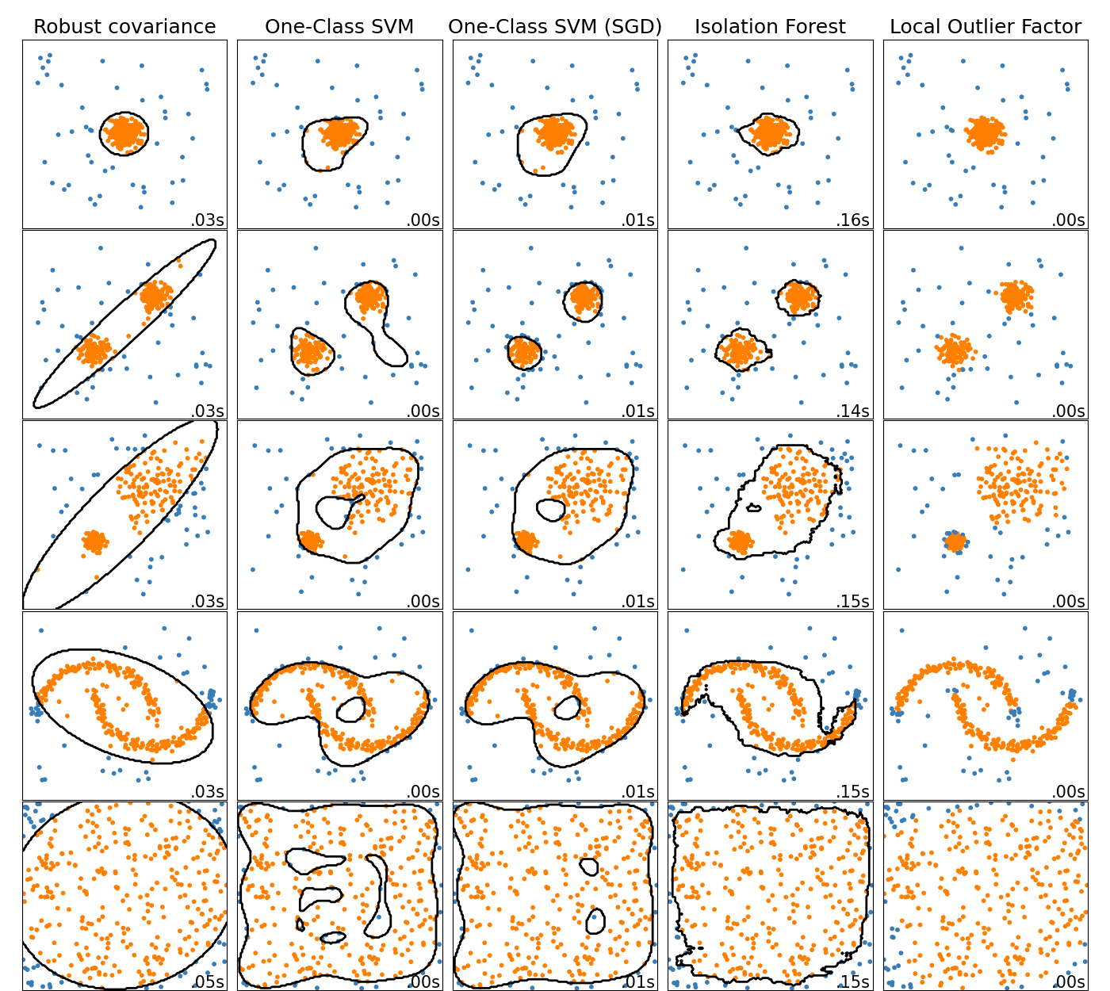
Other outlier detection methods

Slide 33
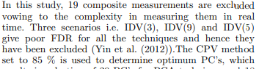
Additional Link
Post on PCA - https://towardsdatascience.com/principal-component-analysis-for-dimensionality-reduction-115a3d157bad
Research Paper - https://www-sciencedirect-com.ressources-electroniques.univ-lille.fr/science/article/pii/S2405896320300860

Slide 34
Title: "Fault Detection in the Tennessee Eastman Process: Overview and Basic Statistical Methods"
Thumbnail: The thumbnail could feature a visual representation of the Tennessee Eastman Process, such as a diagram or a photo of the process, with a subtitle highlighting the use of statistical methods for fault detection.
Description: In this video, we will provide an overview of the Tennessee Eastman Process dataset, which is a benchmark dataset used for evaluating process control and fault detection methods. We will discuss the structure of the dataset, the variables involved, and the types of faults that can occur in the process. We will then introduce basic statistical methods for fault detection, including statistical process control charts, hypothesis testing, and multivariate statistical methods. By the end of this video, viewers will have a good understanding of the dataset and how basic statistical methods can be used for fault detection in the Tennessee Eastman Process.

Slide 35
Dataset: https://www.kaggle.com/datasets/averkij/tennessee-eastman-process-simulation-dataset
Post: https://keepfloyding.github.io/posts/data-explor-TEP-3/

